Slide 1
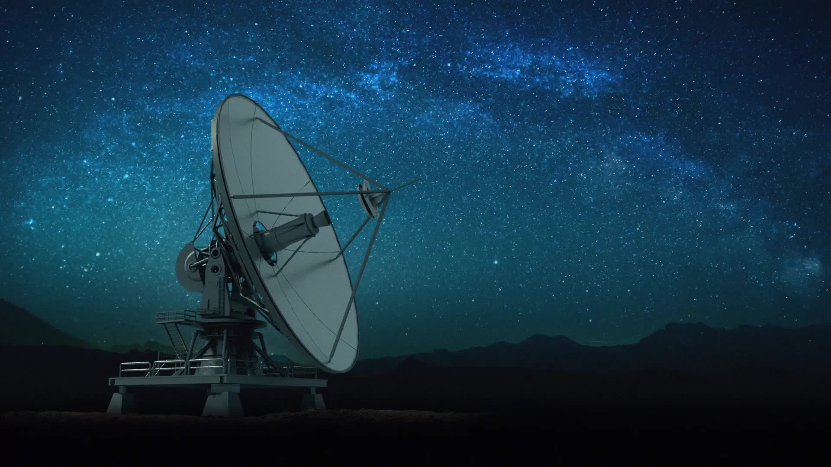
How satellites use the electromagnetic spectrum
Tashi Hatchell

Slide 2
Objectives / Why?
Objectives:
Which frequency bands are most used by satellites?
Examine the relationship between satellite mission types and their frequency band usage.
Why This Topic?
Working in EW
Interest in Satellite Operations

Slide 3
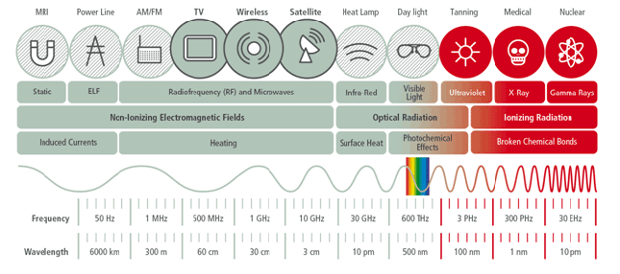
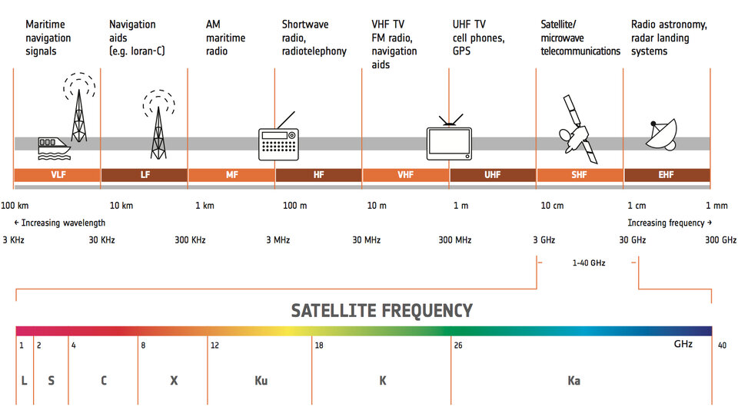
Background Information
Electromagnetic Spectrum
Carry Information in Waves
Frequency Bands
Satellites Transmit & Receive on Different Frequencies
Notes:
🛰️ What is the Electromagnetic Spectrum (EMS)?
- The electromagnetic spectrum (EMS) refers to the entire range of electromagnetic radiation, or light, in the universe. It exists in the form of waves and ranges from radio waves to cosmic rays.
These waves carry energy and can transmit information at different lengths so for example the visible light range of the EM spectrum is what the human eye can see so it is essentially light carrying information about whatever you are looking at to and from your brain and your brain translates that information into something you can understand.
Satellites work in the same way except they mostly use the Infrared to Radio wave range of the EM spectrum and that range is further broken down into frequency bands.
To put it simply, each band has their own data limitations, speed limits, and other factors that make them feasible for certain uses. For example, L-band frequencies are typically used for navigation satellites because they can penetrate clouds, navigation satellites are what the military uses for geolocation and what the average person uses when they use Google Maps, GPS would be useless if it was affected by weather because there are always weather events happening around the world.
Higher frequency bands like Ku and Ka are like the fast lane on the highway, they carry a lot of data but are more susceptible to interference from weather, this is why if you have ever had satellite TV, your TV likely goes out when it rains.
Also, one thing to keep in mind is the frequency band that a satellite uses to transmit can be different from what is uses to receive a signal so GPS satellites for example, in this graph, are shown in the Ka band, that could be the signal it receives from a ground control station rather than the signal it transmits to give GPS data.
Wavelength = length
Frequency = cycle
Radiowaves = longer wavelength, lower frequency
Frequency Range Image;
EM spectrum Image: https://aktinovolia.com/electromagnetic-radiation-spectrum-rf/
📡 What are Frequency Bands?
The EMS is divided into frequency bands to organize and regulate its use. Each band covers a range of frequencies and is typically designated by letters (e.g., L-band, S-band, X-band, Ku-band, Ka-band). For example:
L-band: 1–2 GHz
S-band: 2–4 GHz
X-band: 8–12 GHz
Ku-band: 12–18 GHz
Ka-band: 26–40 GHz
These bands help manage and allocate frequencies for various technologies like communication, radar, navigation, and more.
🛰️ How Satellites Use the EMS
Satellites rely on different parts of the EMS to perform their mission-critical functions: ✅ Communications Satellites use bands like C, Ku, and Ka to relay television, broadband, and voice services. ✅ Earth Observation Satellites often use X-band radar (SAR) to capture detailed images of Earth’s surface. ✅ Navigation Satellites (like GPS) use L-band to deliver reliable positioning signals. ✅ Weather Satellites use S- and X-bands to transmit environmental data and radar imagery.
These frequency bands allow satellites to transmit and receive data effectively, enabling them to fulfill their roles in communication, weather monitoring, Earth imaging, navigation, and more.

Slide 4
Data Sources & Transformations
Frequency Band Proxy Mapping
Mission Purpose | Typical Frequency Band | Examples
Communications | C, Ku, Ka | Satellite TV
Earth Observation | X, S | Synthetic Aperture Radar (SAR)
Navigation | L | GPS, GLONASS, Galileo
Meteorological/Weather Monitoring | S, X | Data relay, radar precipitation sensing
Space Observation | S, X, Ka | Telescopes, deep-space communication
Space Science | S, X, Ka | Science payloads, radio science
Technology Development | S, X, Ka, occasionally Ku | Experimental payloads
USC Satellite Database
Research tool for open-source information
Limitations/Assumptions
Launches through 5/1/2023
Categories Combined
Did not list Frequency Bands
First Mission is Primary Mission
Cleaning & Transformation
Removed unnecessary columns
Narrowed down to launches since 2013
“Exploded” Columns
Assigned Frequency Bands
Notes:
Data Came From:
UCS Satellite BD:
Satellite database assembled by the Union of Concerned Scientists (UCS) who created this as a research tool for anyone to get open-source information on operational satellites.
Reliability
Limitations
Only includes launches through May 1, 2023
A lot of categories were lumped together, i.e. Mission would have more than one mission type or say ‘Other/Unknown’, Mission types would be ambiguous i.e. Technology Development, Earth Science, Educational, User/Operator would have multiple countries or would be an organization like the ESA or simply say Multinational.
It also did not list the specific frequency band that each satellite uses so I created a proxy map, as shown in the image, for each mission type and assigned the typical frequency band that, that function would likely use. This is based on information known about each frequency band and what type of data would be needed to fulfill each mission type. One gap is that is that I won’t be able to know if these frequencies are transmitting or receiving frequencies.
Assumptions:
Outside of the frequency band proxy mapping, one other assumption I made was that if the satellite had multiple missions listed, I assumed the first mission listed was the primary mission and went with just the primary mission as far as data visualization and analysis goes.
Cleaning and Transformation Steps
Got rid of blank columns or columns with note information that I didn’t need and renamed columns to be more concise (i.e. Class of Orbit to just Orbit, Purpose to Primary Mission, etc).
Narrowed down launches to just launches that have occurred since 2013 to keep it within the last 10 years. Mostly because of missing data and some satellites that were launched prior to 2010 are missing data or those satellites are obsolete now.
Used functions to assign frequency bands to each satellite based on primary mission and then used the explode method to make sure each frequency band has its own individual entry, for example if a GPS satellite had multiple bands listed I wanted to make sure it had one entry for Ka, and one entry for L to make sure my analysis was giving accurate numbers for everything.

Slide 5
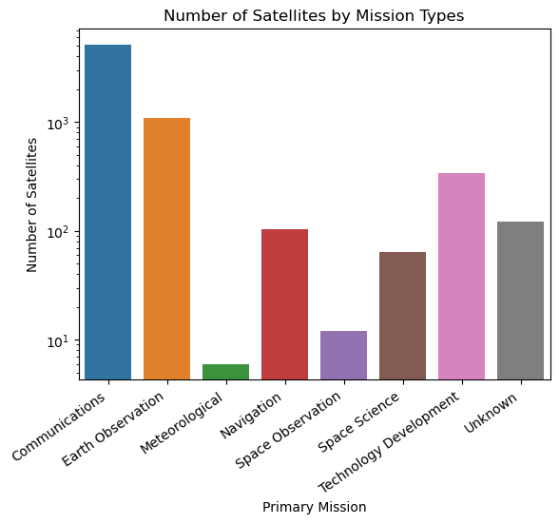
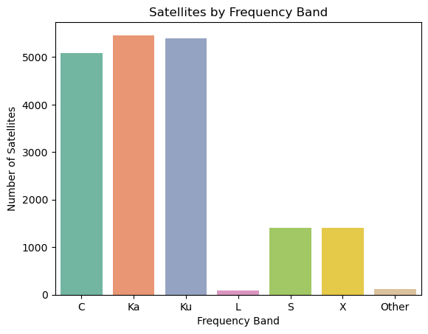
Visualizations
Distribution of Frequency Bands and Missions
Logarithmic Scales
Notes:
First wanted to get an idea of mission types and how many satellites are performing each mission type. I found that Communications missions dominate the mission types with Earth Observation missions not too far behind. This makes sense because Communications dominates a lot of our everyday life from talking on your phone to using the internet even to paying for things if you use things like Apple Pay to make transactions. On the military side obviously, communication is key to mission accomplishment and everyone in all branches uses some type of Communication technique to perform their mission whether it be via the internet and different networks or through two-way handhelds on the ground. One thing of note is that I used a logarithmic scale on this graph just to compress the ranges of values.
I also wanted to see the distribution of satellites by frequency band and found that Ka band is the most used with Ku and C close behind, Ka and Ku make sense because of their high frequency and ability to transfer large amounts of data quickly. I thought it was interesting that L band was so low in comparison because of the amount of navigation satellites out there but that could be attributed to that difference in transmit and receive signals I was discussing earlier. I’ll talk more about the C band being so high in the next slide.

Slide 6
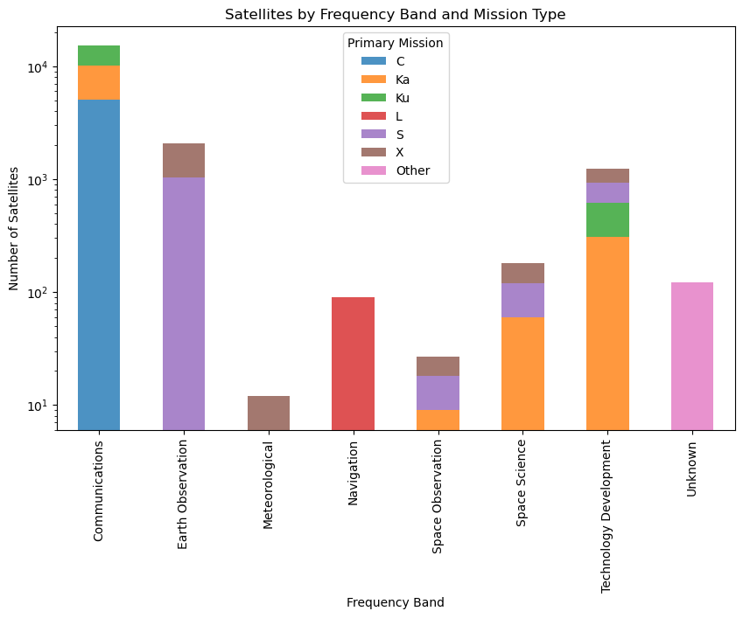
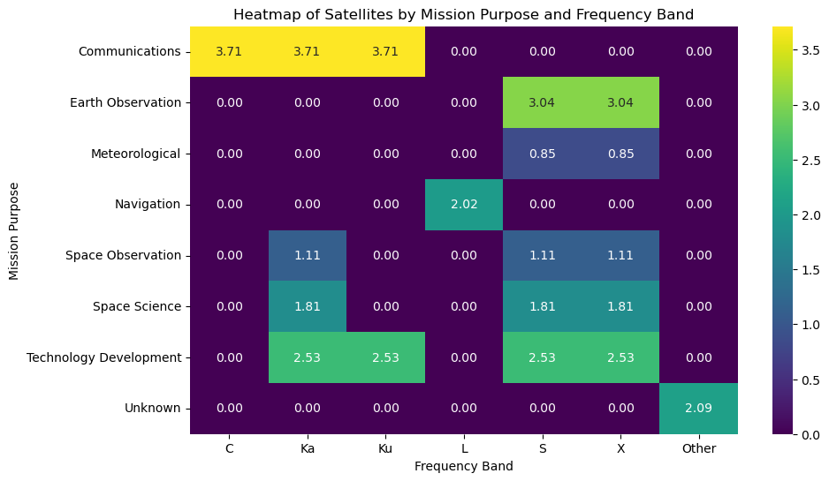
Key Insights
Communications – C
Earth Observation – S/X
Technology Development – Range
Why not the mid-range bands?
Notes:
Despite Ka band being the most used frequency overall, satellites with a primary mission type of Communications primarily use C-band for their operations. That’s likely because C-band frequencies are lower in comparison to Ka and are less affected by weather or atmospheric interference. It can also cover a larger geographic area with fewer ground control stations which makes it ideal essential services like telecommunications, internet service, and general broadcasting. Also thought it was interesting that Earth Observation missions mostly used S and X bands, those bands are considered versatile because they provide a good balance of speed and ability to transfer fairly large loads of data. It is also interesting that Technology Development covers a range of frequencies, mostly focusing on Ka, because this Mission can be comprised of many different sub-missions, but I’d also be curious to know why that range isn’t more skewed toward the S and X bands since those are considered the more versatile, mid-range frequencies.

Slide 7
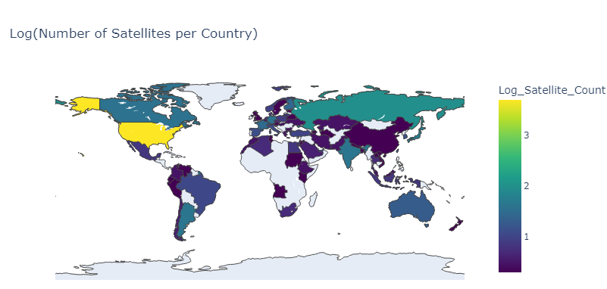
Future Areas of Research
How does solar activity impact the performance and reliability of different frequency bands used by satellites?
What are the main user groups of satellite services (e.g., commercial, military, academic) and how do they use the EM spectrum differently?
How do satellite orbital parameters (LEO, MEO, GEO, HEO) influence the choice of frequency bands?
Predicting future mission types & frequency band usage?
How will emerging satellite mega-constellations (e.g., Starlink, OneWeb) influence the allocation and management of the EM spectrum?

Slide 8

So What?
If you’re a satellite engineer…
Knowing frequency bands helps you pick payloads
If you’re in the military….
Knowing frequency bands helps you effect and mitigate being affected
If you’re a civilian who never thinks about this…
If you use any technology, you should care about satellites
Notes:
Satellite Engineer:
- Knowing frequency bands can help with payload production and can tailor what the payload is programmed to pick based on its given mission set.
Military:
- Knowing frequency bands may help you effect satellites or mitigate being affected. A soldier on the ground with some general knowledge of satellite frequencies and orbit can tailor communication tactics based on what they know about what’s orbiting over them at a given time.
Civilian:
- You may not necessarily need to know the specific frequencies and technical information but having an idea of how these frequencies work can alter your perspective of how reliant you may be on satellite technology and may be able to better help you understand the significance when things like Starlink constellation deployments are covered so heavily in the news and how that might change or improve your day-to-day life.

Slide 9
Contact Info

